Slide 1


BIG DATA IN CRIME RATE ANALYSIS
STUDENT ID | STUDENT NAME
NP03A190113 | KUNGA NYIMA GURUNG
NP03A190055 | MANJIL SHRESTHA

Slide 2

REASON FOR TOPIC SELECTION
The main reason for using this topic is to see how much crime is prevalent in different police agencies around the United States.
Explore data first and draw out questions like:
Is the Crime increasing or decreasing?
Which year has highest and lowest average number crimes?
Determine the safe and dangerous areas, etc.
We may examine crime trends, patterns, and criminal behaviors in the neighborhood using dig data, which may aid in preventing crimes before they occur.

Slide 3


PROBLEM STATEMENT
Crimes are on the rise these days, with various levels of seriousness and versatility.
With the increasing crimes over time, it is unpredictable which area is safe and not.

Slide 4
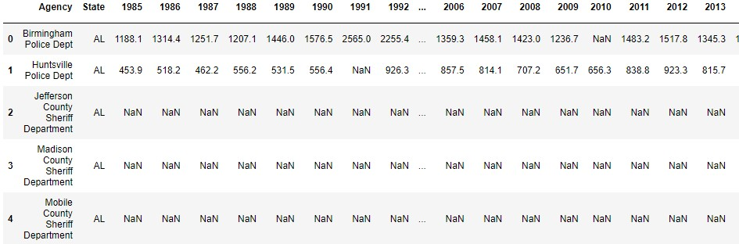

DATASET
Information of different Police Departments in the US, extracted from https://data.world/
Crime Rate from 1985 – 2014.
Data Cleaning needs to be done.

Slide 5
INITIAL HYPOTHESIS
Increasing the security in those places where crimes are more prevalent.
Furthermore, data from previous crimes will aid in achieving a reasonable level of forecast accuracy.

Slide 6
PROBABLE OUTCOME
The probable outcome of this analysis is to determine whether the crime rates in the United States is increasing or decreasing over the time.
Based on the analysis and visualization result, safe and danger zones can be obtained.
It not only makes well-informed decisions, but it also helps to maintain society's dignity by following the law.

Slide 7
THANK YOU !

